Slide 1
Market Segmentation for Senses Coffee company
Hayfa Bu Hazzaa
June 2020

Slide 2
Agenda
Project goal and objectives
Data sources
Data acquisition and cleaning
Basis of Senses Company market segmentation
Using the K-Means clustering and agglomerative clustering algorithms
Results
Recommendations for Senses management
Conclusion

Slide 3

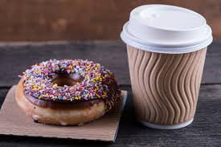
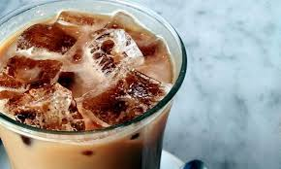
Project goal
This project intends to provide Senses Coffee company’s management and invistors with insightful data that assist them in starting their new business in the largest 100 municipalities in Canada, by segmenting the Canada market into three segments, each segment will be operated by an operation office. Total of three operation offices will be opened in Canada to run the business. Senses Coffee company produce three coffee brands, each brand is targeting a dedicated market, i.e, hotels, bakeries, and grocery stores.
Ellite is fine coffee suitable for hotels markets,
Instance is average coffee that is suitable from taste and price for Bakeries markets,
Chill is an iced coffee that is very popular with good price and suitable for Grocery stores markets.

Slide 4
Project Objectives
Provide the needed information that helps in deciding in which municipality will be managed by which operation office.
Provide the operation offices with the size of the new potential market in each market segment, and this will help them in deciding on the share of the business dedicated to each operation office.
Provide the information that helps Human capital in deciding on the number of employees needed to operate each operation office.

Slide 5
Data Sources
No | Dataset | Description | Data Source
1 | List of the largest 100 municipalities in Canada | Data fields include Municipalities, Province, Growth rate and population. | I scraped the following Wikipedia site to obtain this data https://en.wikipedia.org/wiki/List_of_the_100_largest_municipalities_in_Canada_by_population
2 | Geo-Location data of each municipalitiy in Canada | Data fields include the longitude and latitude coordinates of each municipality. | I obtained this data using the Python geocoding web services API.
3 | Potential customers’ data | Data fields include the venue name, category, longitude and latitude. | I obtained this data by exploring the municipality’s venues using the Foursquare API
4 | Canada map GIS data | Data of Canada with the largest 100 municipalities. | I obtained this data using the Folium API

Slide 6
Data Acqusition and cleansing
No | Dataset | Dataset Type | Description | Number of records
1 | Canadia municipalities raws | Master data | Raw data of the 100 largest canadian municipalities | 1oo
2 | Canadia municipalities used | Master data | Data of municipalities that have venue information in the Foursquare daabase | 100
3 | Canadian municipalities’ venues | Features data | Data if the venues belonging to the 100 municipalities in Canada | 8719
4 | Selected Canadian municipalities’ venues | Cleaned data | Data after taking out the NAN values and dublicated data, and filtering out all venues except the targeted markets (Hotels, Grocery Stores, Bakeries) | 761

Slide 7
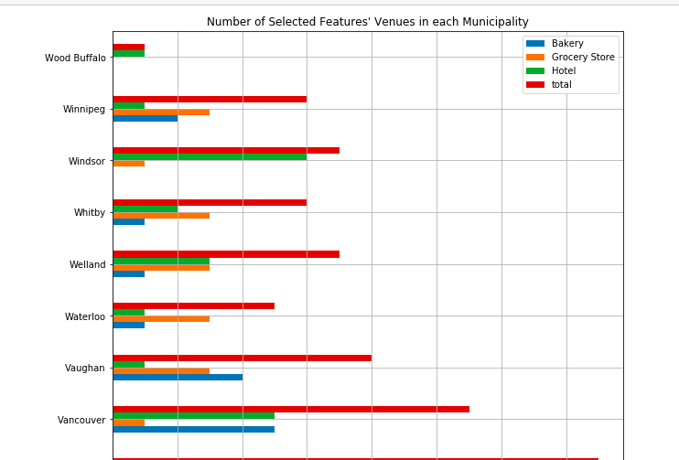
Segmenting Senses Canadian municipalities market
Segmenting based on the frequency of occurance of hotels, bakeries, and grocery stores.

Slide 8
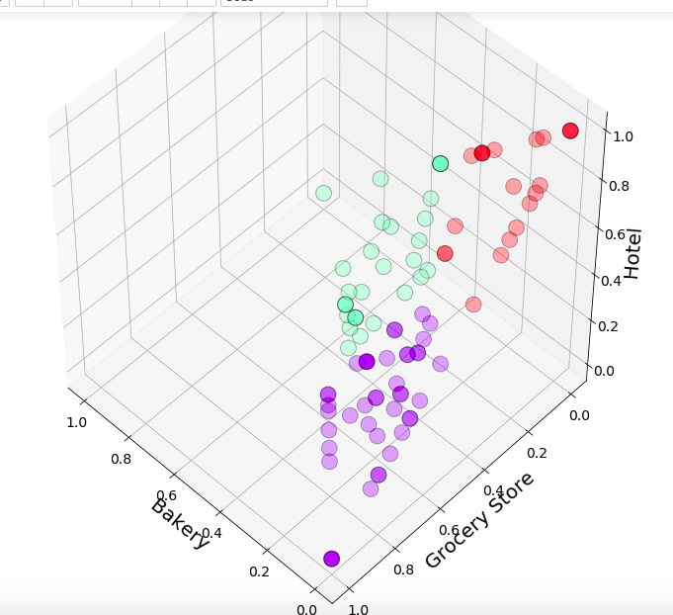
Using the K-Means clustering and agglomerative clustering algorithms
Same results were produced by Both K-Means and Agglomerative Clustering algorithms.

Slide 9
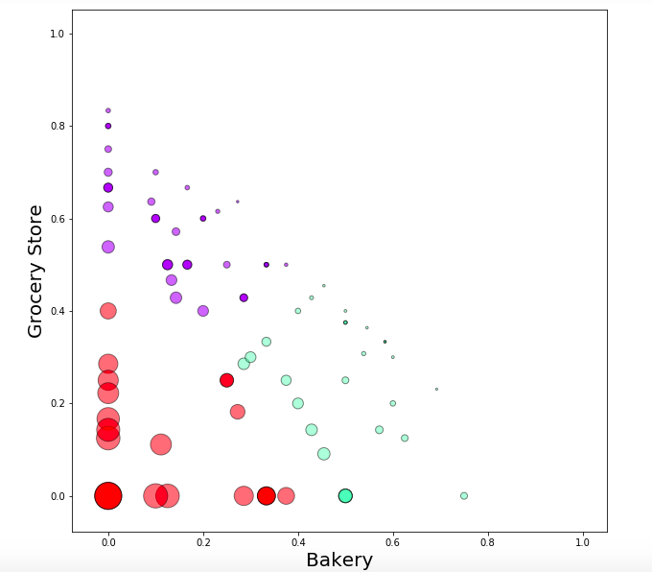
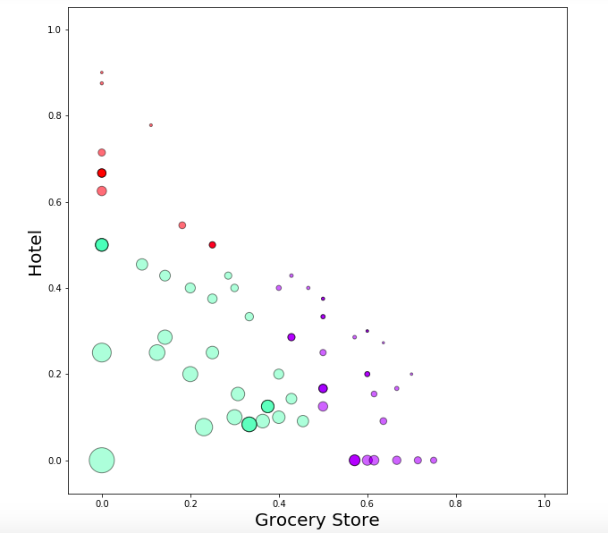
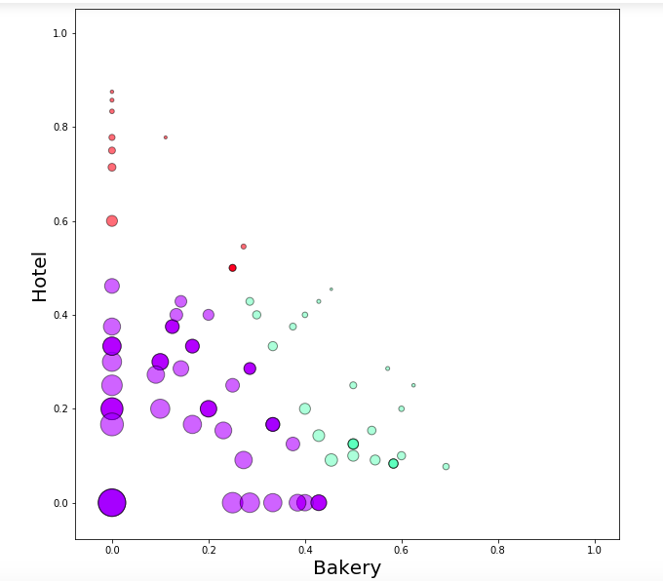
K-MEANS clustering results
Distribution of municipalities based on the frequency of occurrence of
Bakery and Grocery Store venues
Distribution of municipalities based on the frequency of occurrence of
Hotel and Grocery Store venues
Distribution of municipalities based on the frequency of occurrence of
Bakery and Hotel venues

Slide 10
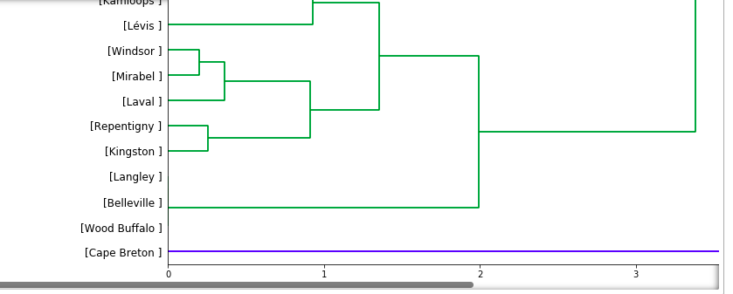
Agglomerative clustering algorithms results
A Dendrogram generated by the hierarchical agglomerative clustering algorithm showing the distribution of Canadian municipalities on the three market segments.

Slide 11
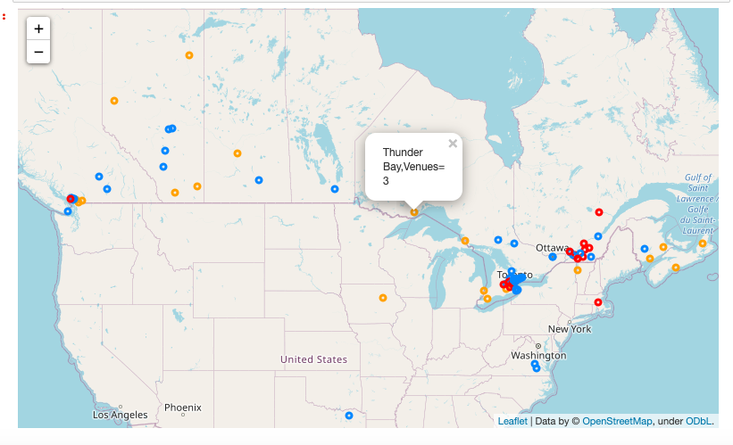
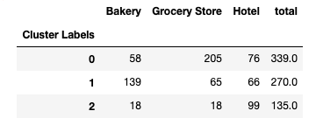
RESULTS
Distribution of Canadian municipalities on the three market segments
Number of Bakery, Grocery Stores & Hotels in each market segment

Slide 12
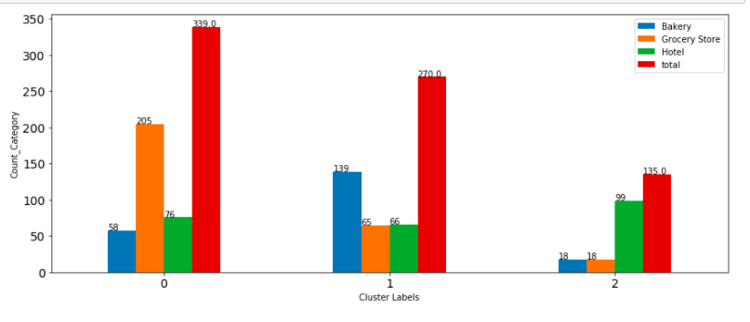
RESULTS
Number of Grocery Stores, hotels and Bakeries in each market segment

Slide 13
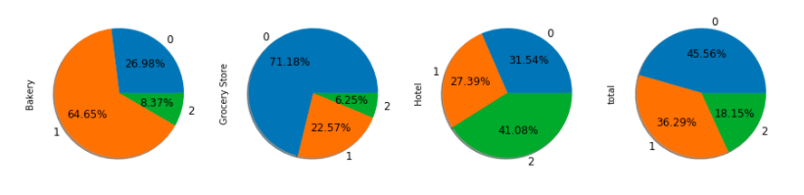
RESULTS
Density of Bakery, Grocery Store and Hotel in each market segment

Slide 14
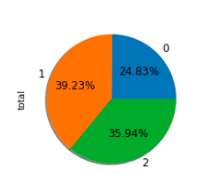
Recommendations for Senses Company’s management
Total number of potential clients in each market segment is somewhat different (339, 270 and 135 for market segments 1,2, and 3 respectively). Based on this data, the management of the company is advised to consider adjusting its organization structure and uplifting its human capital capabilities in order to be able to successfully implement the new marketing strategy and cope with the requirements of the new Canadian market.

Slide 15
Conclustion
This project used the K-Means and the Agglomerative clustering machine learning models to segment the Canadian market of Senses coffee company.
The frequency of occurrence of Hotels, Grocery Stores Bakeries were identified as important features that affect the segmentation of this market.
These models can be very useful in helping Senses management in several ways. For example, it could help develop a new organization chart, and plan the human capital and competencies necessary to implement the company’s new marketing strategy

Slide 16
THANKS YOU

